Slide 1
Hospital Management System
Final Project Presentation for DBS211
Group 04: - Alejandro Mercado Monetti - Renan De Alencar Queiroz - Seulgi Lee

Slide 2
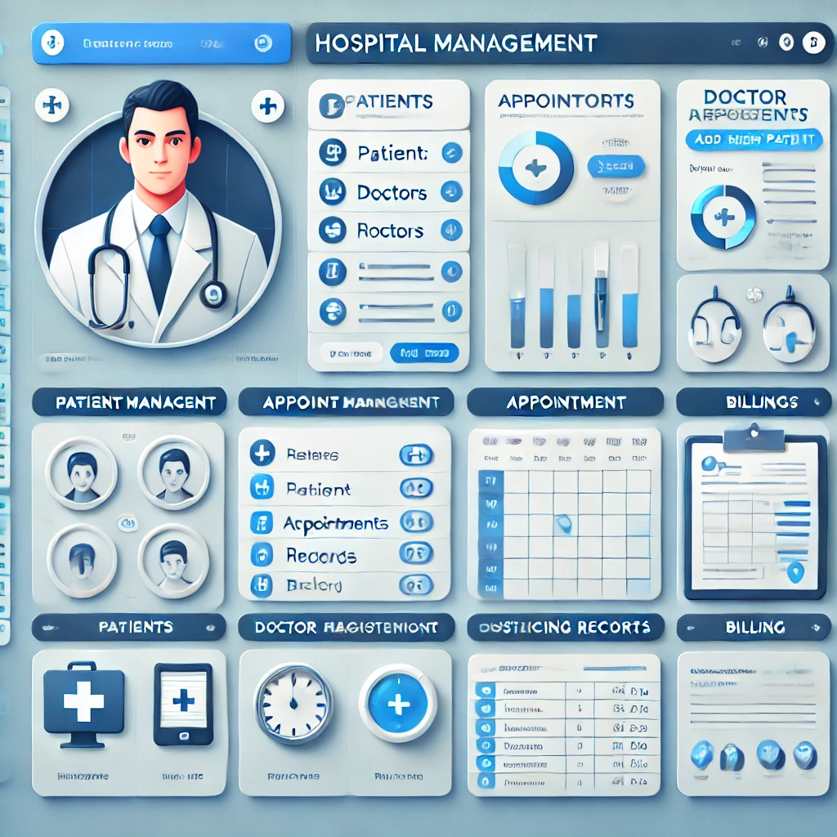
Project description
Develop a Hospital Management System to streamline and automate hospital operations. Key functionalities include: - Patient Management: Register and manage patient information. - Appointment Scheduling: Schedule and manage appointments with doctors. - Doctor Management: Track doctor availability, specialties, and schedules. - Billing: Handle billing information and payment statuses. - Medical Records management: Store patient medical history and treatment records.

Slide 3
Contribution of Group Members
Seulgi Lee: Data Insertion and Business Reports - Create the SQL script to insert sample data into the tables. - Write SQL scripts to create at least 4 VIEWS. - Include a write-up of each business report, explaining its purpose and benefits. - Provide screenshots of the SQL queries and their output.
Alejandro Mercado: Database Creation and ERD - Review and update the ERD based on feedback. - Ensure all PKs, FKs, and relationships are correctly defined. - Fix any many-to-many relationships using bridge entities. - Write the SQL script to create the database and all tables. - Validate the script to ensure it runs without errors both on a new and existing database. - Document the database schema and design decisions.
Renan Queiroz: Testing, Presentation, and Final Submission - Execute all SQL scripts and verify data integrity and relationships between tables. - Create a presentation describing: Problem statement and project description. - Compile the main Word document with all updates and changes based on feedback.

Slide 4
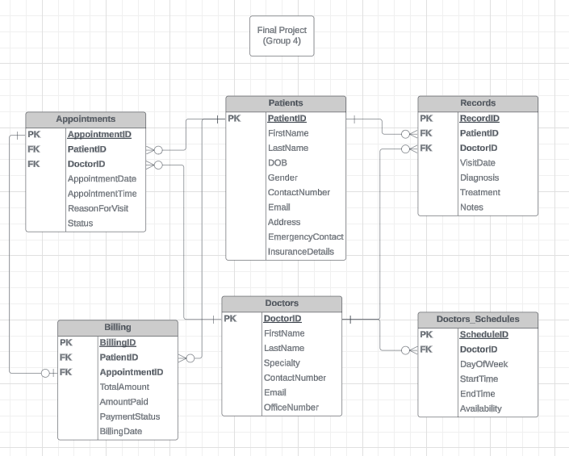
Overview of the Database Design
The Hospital Management System database consists of several interconnected tables to efficiently manage hospital operations:
- The Patients table stores personal and contact information of patients.
- The Doctors table holds professional details of doctors.
- The Appointments table manages patient-doctor appointments, linking to the Patients and Doctors tables through foreign keys.
- The Records table stores medical visit details, including diagnosis and treatment, also linked to Patients and Doctors.
- The Billing table handles billing information, associating appointments with payment details and patient information.
- The Doctors_Schedules table manages doctors' availability.

Slide 5
Overview of the Database Design
Relationships Overview:
Patients and Appointments: One patient can have multiple appointments.
Doctors and Appointments: One doctor can have multiple appointments.
Patients and Records: One patient can have multiple medical records.
Doctors and Records: One doctor can have multiple medical records.
Patients and Billing: One patient can have multiple billing records.
Appointments and Billing: One appointment can have one billing record.
Doctors and Doctors_Schedules: One doctor can have multiple schedule entries.

Slide 6
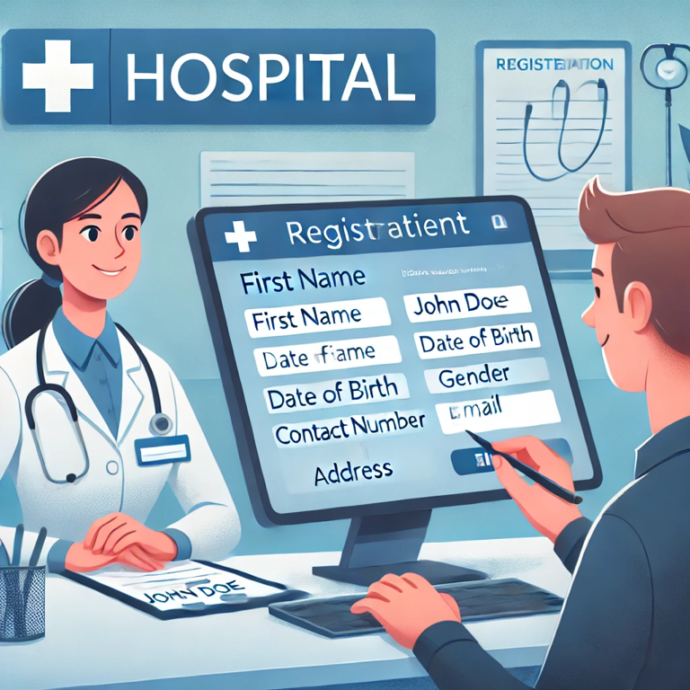


Business report - Bob McKenzie’s Appointment and Medical Record Journey
Explanation of how the system works.
Bob McKenzie, a new patient, arrives at the hospital and provides his personal information to register.
Input Data
Output Data

Slide 7
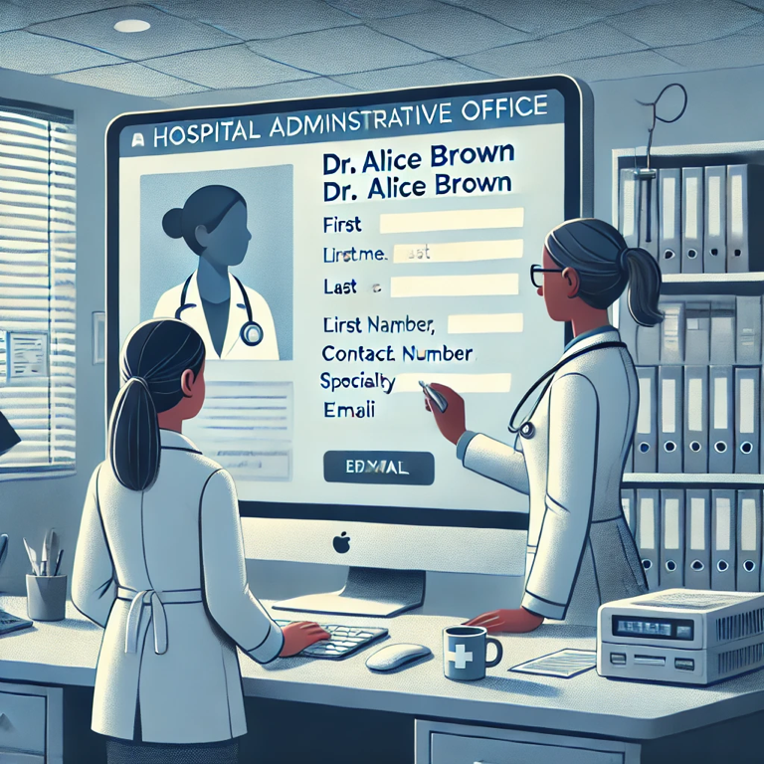


Business report - Bob McKenzie’s Appointment and Medical Record Journey
Explanation of how the system works.
2. Dr. Alice Brown, a cardiologist, is registered in the hospital’s system.
Input Data
Output Data

Slide 8
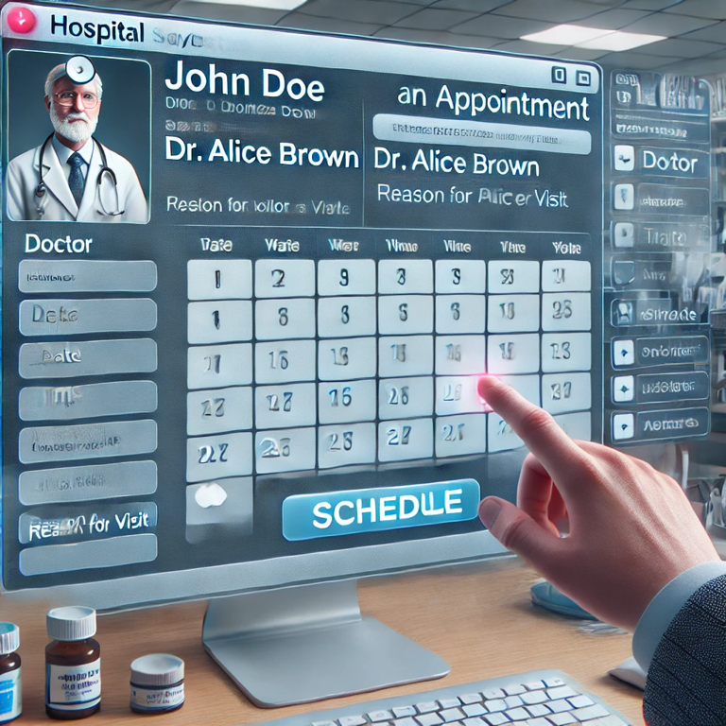


Business report - Bob McKenzie’s Appointment and Medical Record Journey
Explanation of how the system works.
3. Bob McKenzie schedules an appointment with Dr. Alice Brown for a regular checkup.
Input Data
Output Data

Slide 9



Business report - Bob McKenzie’s Appointment and Medical Record Journey
Explanation of how the system works.
4. Dr. Alice Brown’s schedule is updated to reflect her availability.
Input Data
Output Data

Slide 10



Business report - Bob McKenzie’s Appointment and Medical Record Journey
Explanation of how the system works.
5. Bob McKenzie visits Dr. Alice Brown for his scheduled checkup on August 5, 2024. During the visit, Dr. Brown diagnoses Bob with hypertension and prescribes medication.
Input Data
Output Data
Output Data

Slide 11
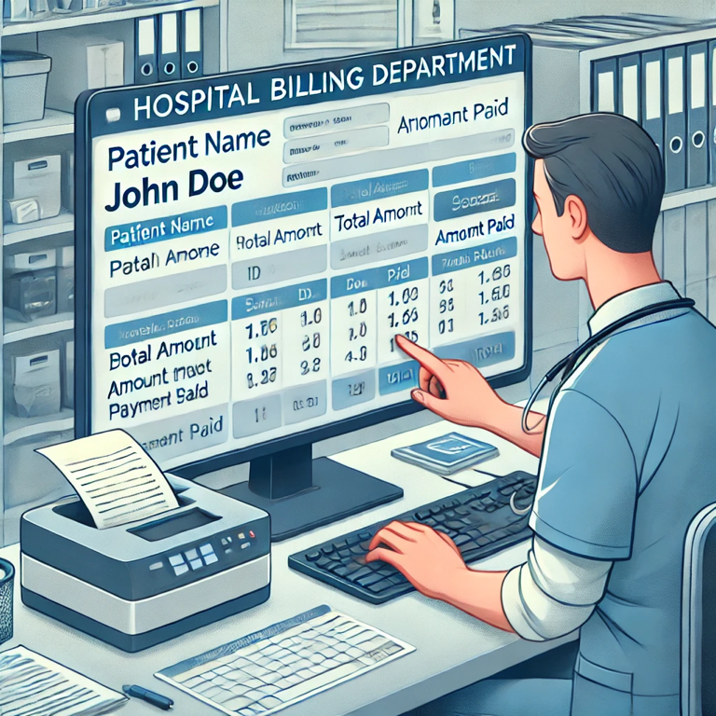


Business report - Bob McKenzie’s Appointment and Medical Record Journey
Explanation of how the system works.
6. The hospital generates a bill for Bob McKenzie visit. The total amount for the consultation is $200, which Bob pays $100. The payment status is defined as unpaid showing that a debt exists.
Input Data
Output Data

Slide 12
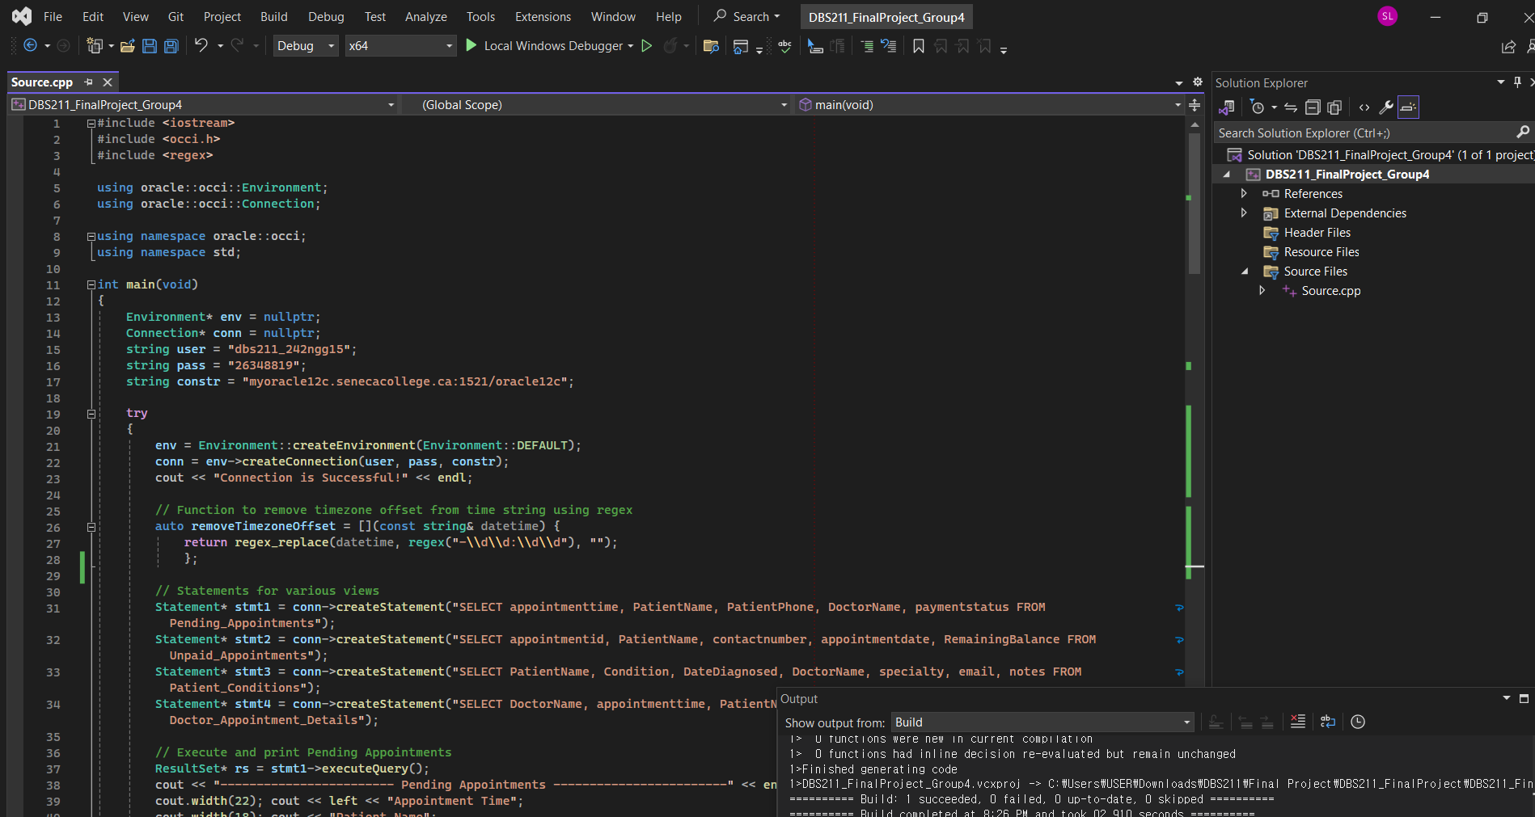
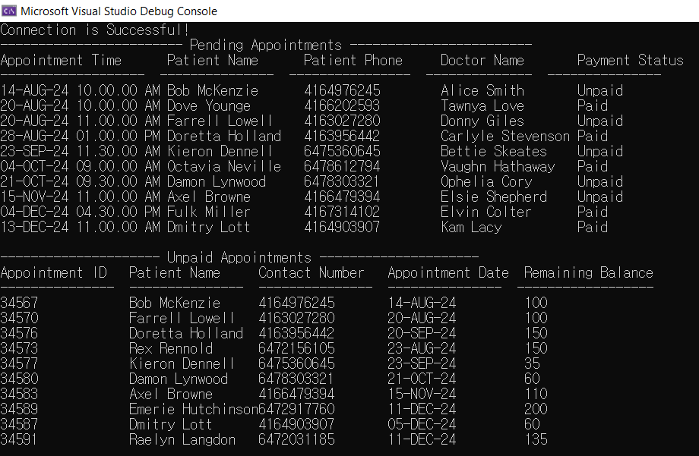
Information Retrieval from Visual Studio
Executing several SQL queries in Visual Studio to retrieve information from our database.
Listing all patients with pending appointments and unpaid appointments.

Slide 13
CONCLUSION
The system enhances efficiency, reduces errors, and improves patient care.
Summary of Actions:
1. Register a new patient.
2. Register a new doctor.
3. Schedules an appointment with a doctor
4. Update doctors’ availability
5. Create medical records
6. Billing information for the appointment is recorded.

